Slide 1
Employee Data Analysis using Excel
STUDENT NAME: RADHIKA A
REGISTER NO: 651DE56D2287E3BAA8C4002256F42006 ,312208745
DEPARTMENT:B.COM [GENERAL]
COLLEGE: MEENAKSHI COLLEGE FOR WOMEN

Slide 2
PROJECT TITLE
Employee Data Analysis based on gender and department and salary using Excel

Slide 3


AGENDA
Problem Statement
Project Overview
End Users
Our Solution and Proposition
Dataset Description
Modelling Approach
Results and Discussion
Conclusion
3/21/2024 Annual Review

Slide 4

PROBLEM STATEMENT
To analyze the gender distribution across various departments within the organization, identify data gaps such as unclassified gender entries and employees not assigned to specific departments, and provide recommendations to address these issues and enhance gender diversity. The dataset includes 189 employees across various departments. The gender distribution is nearly balanced, with 91 females and 92 males. However, there are 6 entries with missing gender information and 7 employees categorized under "NULL" for department assignment.
The data reveals a generally balanced gender distribution across the organization, with 91 females and 92 males. However, certain departments, like Engineering and Research and Development, display significant gender imbalances, which could indicate a need for targeted diversity initiatives. Additionally, the presence of 6 employees with unclassified gender ("blank") and 7 employees listed under "NULL" for department suggests gaps in the data that could impact the accuracy of any further analysis. Addressing these gaps is crucial for ensuring accurate employee records and fostering an inclusive work environment. We recommend prioritizing data completeness by properly classifying all employee records and implementing diversity programs in underrepresented departments to enhance gender balance.

Slide 5

PROJECT OVERVIEW
Analyzing employee data by gender, department, and salary provides crucial insights into pay equity and departmental compensation trends. This analysis helps identify any disparities in salary distribution, ensuring fair and competitive compensation practices. By uncovering potential imbalances, organizations can address gender pay gaps, enhance employee satisfaction, and improve retention. Additionally, it supports compliance with legal standards and informs strategic decisions regarding compensation and resource allocation, ultimately fostering a more equitable and transparent workplace.
V
c

Slide 6

WHO ARE THE END USERS?
In analyzing data by department, salary, and gender, key users include Human Resources (HR) professionals, who utilize the data to ensure fair compensation and address pay equity issues; Payroll and Compensation Specialists, who manage salary administration and need insights for budgeting; Organizational Leadership, which uses the data for strategic decisions and aligning compensation with company goals; and Diversity and Inclusion (D&I) teams, which focus on promoting fairness and addressing potential biases. Additionally, Financial Analysts use the data for budgeting and financial planning, while employees and their representatives may seek transparency regarding salary equity.

Slide 7

OUR SOLUTION AND ITS VALUE PROPOSITION
Comprehensive Salary Analysis by Department
Pivot Table Insight: Our pivot table provides a clear breakdown of average salaries across different departments.
Value Proposition: This enables organizations to identify any significant salary discrepancies between departments, facilitating targeted adjustments and ensuring equitable compensation practices.
2. Streamlined Data Visualization
Pivot Table Insight: Visual representations, such as bar or column charts derived from the pivot table, highlight salary distributions by department.
Value Proposition: Easy-to-understand visuals help stakeholders quickly grasp salary trends and make informed decisions about resource allocation and compensation strategies.
3. Enhanced Budget Planning
Pivot Table Insight: Detailed salary data organized by department allows for precise budget forecasting and planning.
Value Proposition: This supports effective financial management and ensures that compensation expenses align with departmental budgets and overall organizational goals.

Slide 8
Dataset Description
This dataset provides a breakdown of the count of salaries by gender and department within an organization.
Departments (Row Labels): Represents various departments within the organization.
Genders (Column Labels): Includes counts for Female, Male, and an unspecified category (blank).
Count of Salaries: Indicates the number of employees within each department and gender category.
Grand Total: Provides the total number of employees across all departments and genders.
Detailed Breakdown:
Accounting: 8 Female, 10 Male, 1 unspecified, totaling 19 employees.
Business Development: 9 Female, 12 Male, totaling 21 employees.
Engineering: 3 Female, 10 Male, totaling 13 employees.
Human Resources: 5 Female, 5 Male, 2 unspecified, totaling 12 employees. .Overall Totals: Across all departments, there are 91 Female, 92 Male, and 6 unspecified employees, summing up to a total of 189 employees.

Slide 9

THE "WOW" IN OUR SOLUTION
Gender and Departmental Balance Analysis: In our analysis of gender distribution across departments, we've uncovered key insights that can drive meaningful change within the organization. The data reveals a commendable overall gender balance, with 91 females and 92 males. However, certain departments, such as Engineering and Research and Development, show a significant gender disparity, skewed heavily towards males. Conversely, departments like Training and Services have a strong female representation.
Data Gaps and Anomalies: We identified critical data gaps, including missing gender information for 6 employees and 7 employees not being assigned to any department ("NULL"). This incomplete data could skew further analysis and decision-making, underscoring the need for improved data management practices.
Actionable Recommendations: To address these disparities and data gaps, we recommend targeted diversity initiatives in underrepresented departments and an immediate review to fill missing data. By fostering a more inclusive environment and ensuring data completeness, the organization can enhance its workforce diversity and make more informed strategic decisions.
3/21/2024 Annual Review
9

Slide 10
MODELLING
Data Cleaning:
Handling Missing Values: Address the missing gender data represented as "(blank)" by investigating if these can be classified based on other available information, or marked for follow-up.
Departmental "NULL" Entries: Investigate and appropriately categorize employees listed under "NULL" to ensure accurate departmental classification.
2. Data Aggregation:
Group by Department and Gender: Aggregate the data to calculate the total number of males, females, and unclassified gender employees within each department.
Calculate Percentages: For each department, calculate the percentage representation of each gender to better visualize disparities.
3. Statistical Analysis:
Gender Distribution Analysis: Perform a statistical analysis to identify departments with significant gender imbalances. This could involve comparing department gender ratios to industry standards or organizational diversity goals.
10

Slide 11
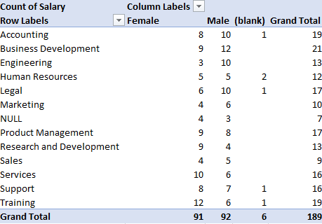
RESULTS
1
11

Slide 12
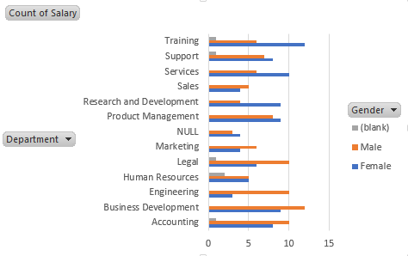
2.CLUSTERED BAR DIAGRAM

Slide 13
conclusion
The analysis of gender distribution across departments reveals a generally balanced representation of male and female employees within the organization, with 91 females and 92 males. However, specific departments, such as Engineering and Research and Development, exhibit significant gender imbalances, with a notably higher proportion of male employees. Additionally, the presence of unclassified gender entries ("blank") and employees categorized under "NULL" for department assignment indicates data gaps that need to be addressed to ensure the accuracy and completeness of employee records.
To foster a more inclusive work environment and improve gender diversity, it is recommended to implement targeted diversity initiatives in departments with noticeable gender disparities. Moreover, a thorough review and update of employee records are necessary to fill in missing gender and departmental information, which will enhance the reliability of future analyses and support the organization's broader diversity and inclusion goals. By addressing these issues, the organization can take significant steps towards achieving a more balanced and equitable workplace.

